Slide 1
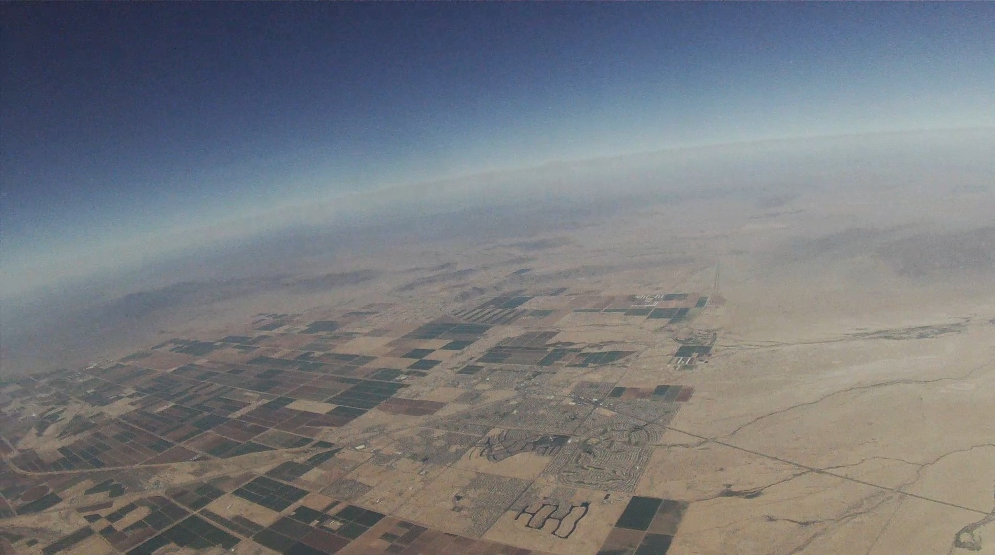
DATA
Batteries
Loss (ejected)
Camera
Detached from its holder
Loss (ejected)
Sensors
Were not damaged but tangled up due to risers detaching from sidewalls
Recovered
During the flight our sensors failed to collect data due to a complication of our code and the processor
Thank you SMCC groups for sharing their pictures and data

Slide 2
DATA
Capsule
Experienced a strong collision
Two Large cracks down the sides
Top lid broken 55% recovered
Bottom lid broken 70% recovered
Loss (damage)
Wiring
95% held together
Recovered
During the flight our sensors failed to collect data due to a complication of our code and the processor
Thank you SMCC groups for sharing their pictures and data

Slide 3
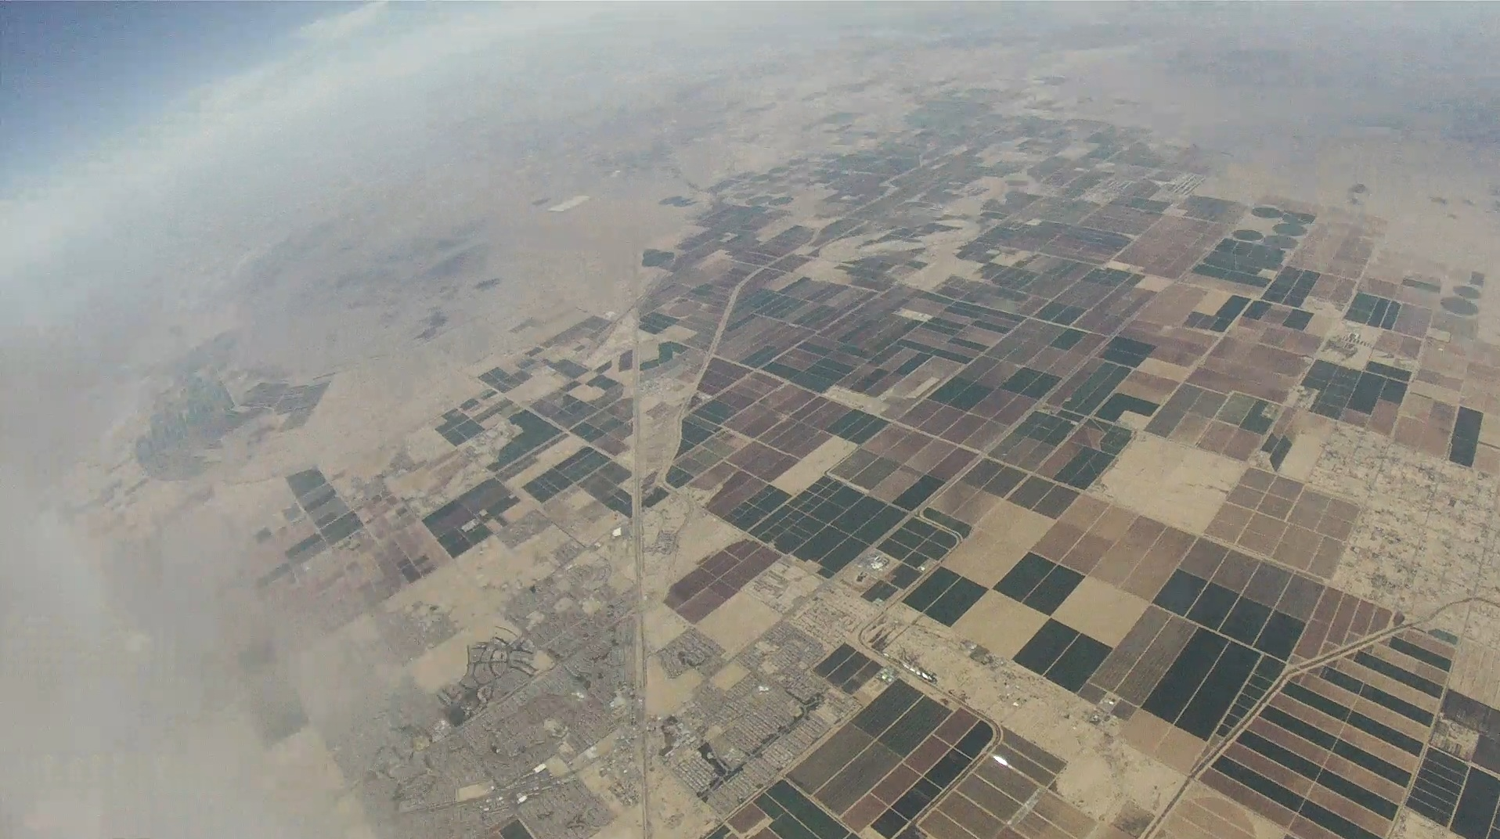
What possibly happened to the capsule during the free fall
The change in temperature
This may of caused the plexigalss capsule to become fragile

Slide 4
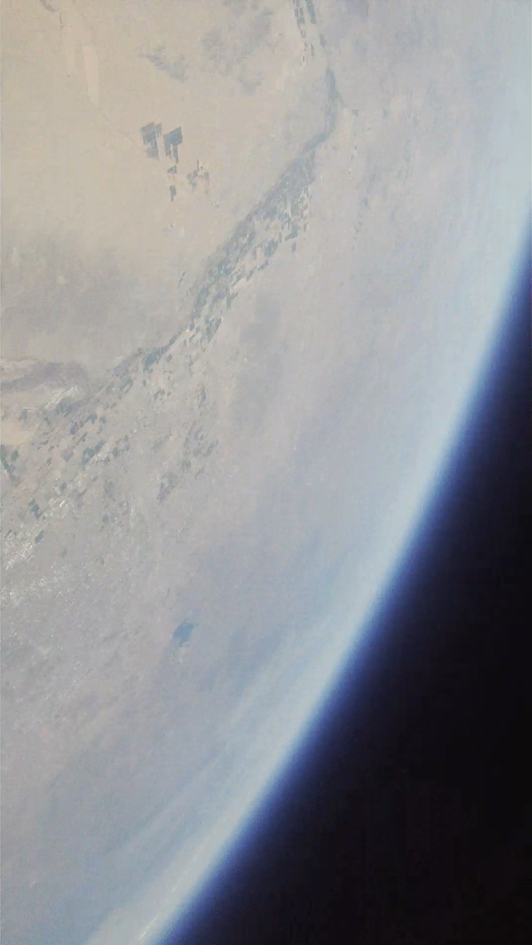
What possibly happened to the capsule during the free fall
Having only a center post connecting the top and bottom lids may have weakened the lids and detached them

Slide 5
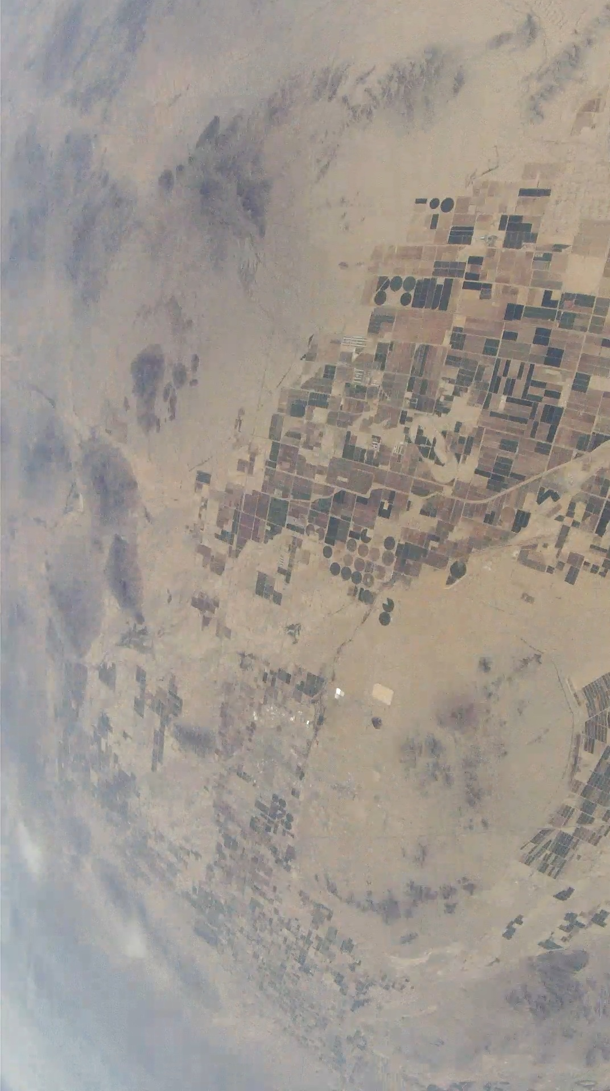
What possibly happened to the capsule during the free fall
Colliding with other capsules
Since the capsules are falling they are not traveling the same speeds due to their weights and drag. This will have the capsules whipping each other around.

